Slide 1


Q1 Update
The vLLM Meetup at Meta
The vLLM Team

Slide 2
Cody (@comaniac)
Staff Software Engineer at Anyscale
↳ Founding Engineer at Boson AI
↳ Senior Applied Scientist at AWS AI
↳ PhD’19, UCLA
vLLM Committer

Slide 3
Agenda
vLLM V1
DeepSeek Enhancements
Q1 Roadmap Update
Ecosystem Projects

Slide 4
vLLM's Goal
Build the fastest and
easiest-to-use open-source
LLM inference & serving engine

Slide 5



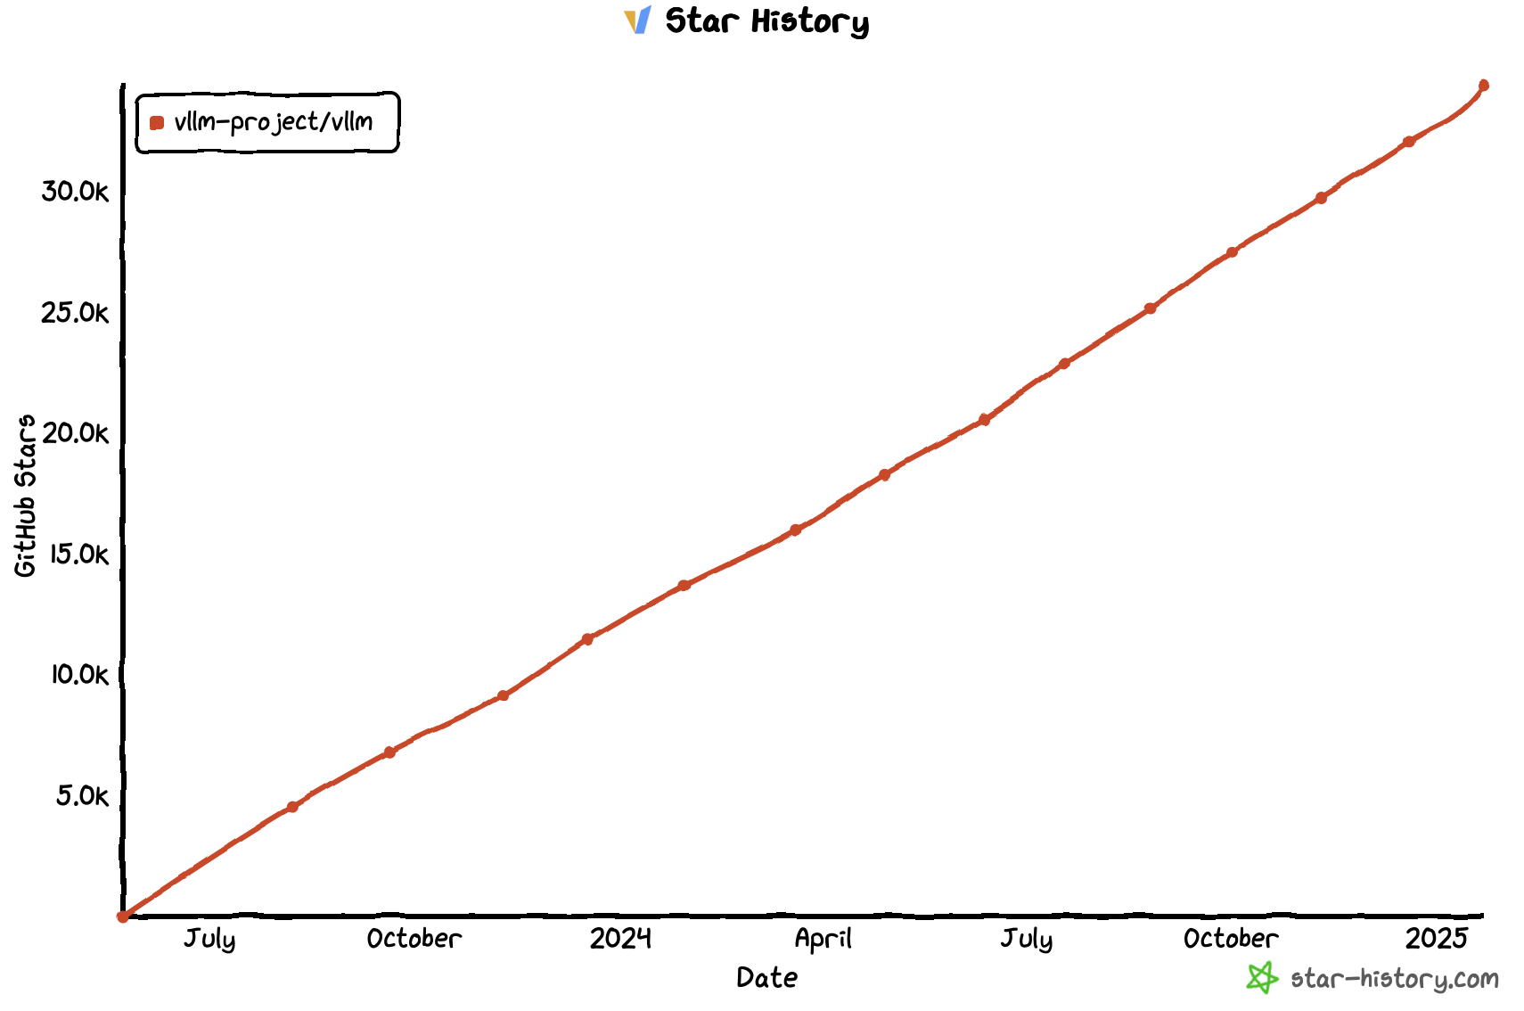
vLLM Today
https://github.com/vllm-project/vllm
$ pip install vllm
39.2K Stars
Official
release!

Slide 6
vLLM API (1): LLM class
A Python interface for offline batched inference
from vllm import LLM
# Example prompts.
prompts = ["Hello, my name is", "The capital of France is"]
# Create an LLM with HF model name.
llm = LLM(model="meta-llama/Meta-Llama-3.1-8B")
# Generate texts from the prompts.
outputs = llm.generate(prompts) # also llm.chat(messages)]

Slide 7
vLLM API (2): OpenAI-compatible server
A FastAPI-based server for online serving
Server
$ vllm serve meta-llama/Meta-Llama-3.1-8B
Client
$ curl http://localhost:8000/v1/completions \
-H "Content-Type: application/json" \
-d '{
"model": "meta-llama/Meta-Llama-3.1-8B",
"prompt": "San Francisco is a",
"max_tokens": 7,
"temperature": 0
}'

Slide 8
vLLM V1

Slide 9
What is vLLM V1?
Re-architect the “core” of vLLM
based on the lessons from V0 (current version)
Unchanged
Changed
User-level APIs
Models
GPU Kernels
Utility functions
...
Scheduler
Memory Manager
Model Runner
API Server
...

Slide 10
Why vLLM V1?
Main goals:
Simple & easy-to-hack codebase
vllm/v1/core/scheduler.py 608 LOC (>2k LOC in v0)
High performance with near-zero CPU overheads
Combining all key optimizations & enabling them by default

Slide 11
Key changes in vLLM V1
Optimized engine loop & API server
Simplified scheduler
Clean implementation of distributed inference
Piecewise CUDA graphs

Slide 12
Key changes in vLLM V1
Optimized engine loop & API server
Simplified scheduler
Clean implementation of distributed inference
Piecewise CUDA graphs

Slide 13
Simplified Scheduler
Synchronous single-step scheduler
Chunked prefills (aka Dynamic SplitFuse) by default
The scheduling decision is simply represented as a dictionary of {request_id: num_tokens}
R1
R2
Prompts
R3
Token budget (10)
Scheduler Output
{request: num_tokens}
Step 0
{R1: 3, R2: 5, R3: 2}
Step 1
{R1: 1, R2: 1, R3: 8}
Step 2
{R1: 1, R2: 1, R3: 2}
Step 3
{R1: 1, R2: 1, R3: 1}

Slide 14
Simplified Scheduler (cont’d)
Unification of “prefill” and “decode”
In V1, there’s no concept of prefill and decode
Schedule based on the difference between num_compute_tokens and len(all_token_ids)
Ex1) “Prefill” & “Decode”
num_computed_tokens: 0
all_token_ids
AI | is | the | future | of
Schedule 5 tokens (“prefill”)
num_computed_tokens: 5
AI | is | the | future | of
tech
all_token_ids
Schedule 1 token (“decode”)

Slide 15
Simplified Scheduler (cont’d)
Unification of “prefill” and “decode”
In V1, there’s no concept of prefill and decode
Schedule based on the difference between num_compute_tokens and len(all_token_ids)
Ex2) Chunked prefills
num_computed_tokens: 0
all_token_ids
AI | is | the | future | of
Schedule 3 tokens out of 5
num_computed_tokens: 3
AI | is | the | future | of
all_token_ids
Schedule 2 tokens

Slide 16
Simplified Scheduler (cont’d)
Unification of “prefill” and “decode”
In V1, there’s no concept of prefill and decode
Schedule based on the difference between num_compute_tokens and len(all_token_ids)
Ex3) Prefix caching
num_computed_tokens: 2
all_token_ids
AI | is | the | future | of
Cache hit!
Schedule 3 tokens

Slide 17
Simplified Scheduler: Next Steps
Current: First-come-first-served policy is baked in the scheduler
Next step 1: Support various scheduling policies
Priority-based scheduling
Fair scheduling
Predictive scheduling
Next step 2: Pluggable scheduler
E.g., workload-specific scheduler
E.g., different schedulers for different hardware backends

Slide 18
Piecewise CUDA Graphs
Q
K
V
V0: Single CUDA graph for the entire model
Pros: Minimal CPU overheads in model execution
Cons: Limited flexibility
Static shapes are required
No CPU operations are allowed
→ Increased development burden
MLP 1
MLP 0
O
Attention
Q
K
V

Slide 19
Piecewise CUDA Graphs (cont’d)
Q
K
V
MLP 1
CUDA graph N
MLP 0
Graph split using torch.compile
O
Attention
PyTorch Eager
Q
K
V
CUDA graph N-1

Slide 20
Piecewise CUDA Graphs (cont’d)
Q
K
V
V1: Splits the model into pieces
Runs the attention op in eager-mode PyTorch
Runs other ops with CUDA graphs
Easy to capture, since the ops are token-wise
Critical to capture the all-reduce op
Pros: Maximum freedom in implementing the attention op
No restriction on shapes
Any CPU operations are allowed
Cons: CPU overheads unhidden by CUDA graphs could slow down the model execution
Negligible for 8B+ models on H100
MLP 1
MLP 0
O
Attention
Q
K
V

Slide 21
Potential Use Cases of Piecewise CUDA Graphs
Piecewise CUDA graphs will allow vLLM to easily integrate new optimizations such as:
Cascade Attention
KV cache offloading to CPU memory (#11532)
KV cache offloading to disk
Sparse KV cache
Brand-new attention algorithms
. . .

Slide 22
V1 Current Status
Set VLLM_USE_V1=1 to use the V1 engine
Same end-user APIs as V0 (OpenAI server & LLM class)
On by default for supported use cases in the upcoming v0.8.0 release.
Supported models
Decoder-only Transformers (e.g., Llama, Mixtral)
Llava-style LMMs (e.g., Qwen2.5-VL, Pixtral)
Features
Supported: chunked prefills, prefix caching, tensor parallelism, LoRA, spec decoding (n-gram only for now), pipeline parallelism, structured outputs
Only supports NVIDIA GPUs for now
AMD, TPU, HPU work in progress

Slide 23

DeepSeek Support

Slide 24
State of DeepSeek Model Support
4 Major Performance Levers:
MLA: Multi-head Latent Attention (✅ v0, ⌛v1)
MTP: Multi-Token Prediction (✅ v0, ⌛v1)
EP: Expert Parallelism (✅v0, ⌛v1)
DP: Attention Data Parallelism (❎v0, ⌛v1)
vLLM’s unique features:
Pipeline Parallelism
Integration with SOTA kernels (FlashMLA, FlashInfer, FlashAttention)
More spec decode methods (ngrams, draft based, etc)
Ecosystem of RLHF integrations, offline inference & serving infra

Slide 25
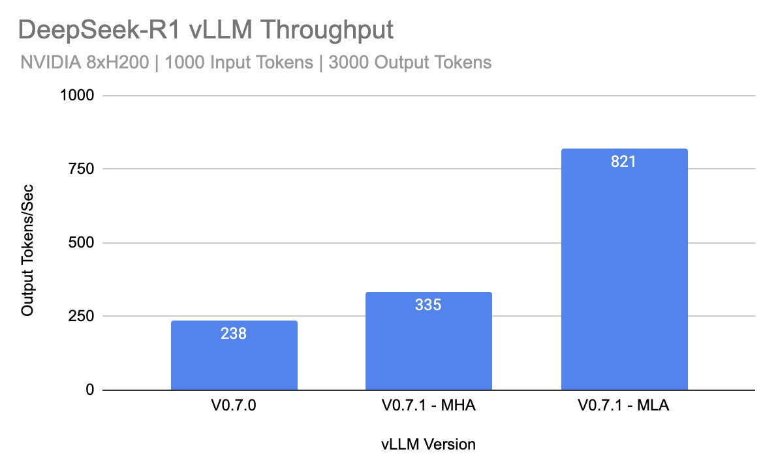
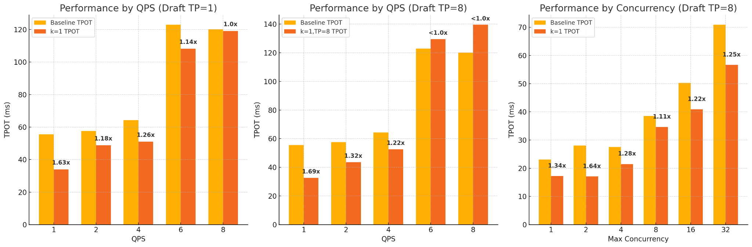
V0 Results of MLA and MTP
Multi-head Latent Attention: 2.4x decoding throughput against MHA
Multi-token prediction (k=1): Improve TPOT with low QPS

Slide 26
Q1 Roadmap

Slide 27
vLLM Core
⌛Ship a performant and modular V1 architecture
⌛ V1 on by default
✅ Spec decode
⌛Hybrid memory allocator
🏗️Documentation and Design Docs
Support large and long context models
✅ Sparsity in attention and MoEs
⌛ Disaggregated prefill support
Improved performance in batch mode
✅ RLHF
⌛ Long Generation

Slide 28
Features
Model Support
✅ Arbitrary HF model
⌛Alternative checkpoint format
Hardware Support
⌛Blackwell
⌛Improved Tranium/Inferentia, Gaudi
⌛Productionize and support large scale deployment of vLLM on TPU
✅ Out of tree support for IBM Spyre and Ascend
Optimizations
⌛ AsyncTP/Flux
✅ FlashAttention3
Usability
⌛Multi-platform wheels and distributions

Slide 29
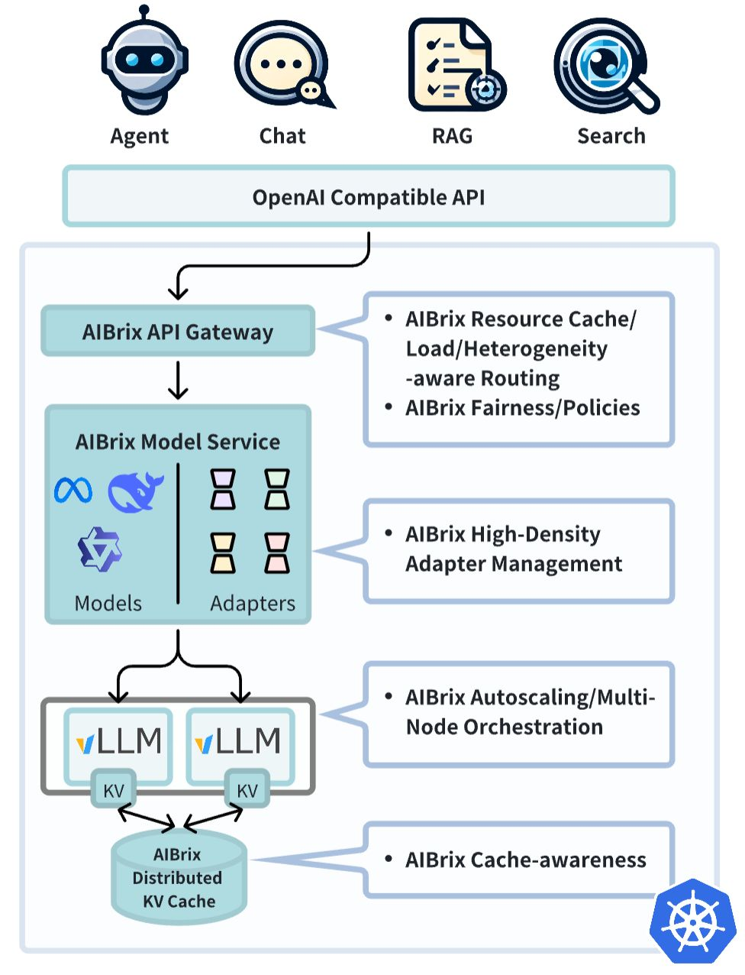
Ecosystem Projects
Welcome AIBrix!
🤔 Distributed batch inference
✅ Large scale serving
✅ Prefix aware router
🤔 Multi-modality output

Slide 30



Scale out LLM inference with Ray
You have prototyped your application using vLLM, and you are now ready to deploy it in production at scale
And more in the future
Ray 2.43 release (just today!) introduces vLLM specialist supports
ray.serve.llm: Large scale and reliable serving
ray.data.llm: Distributed batch inference for data processing

Slide 31
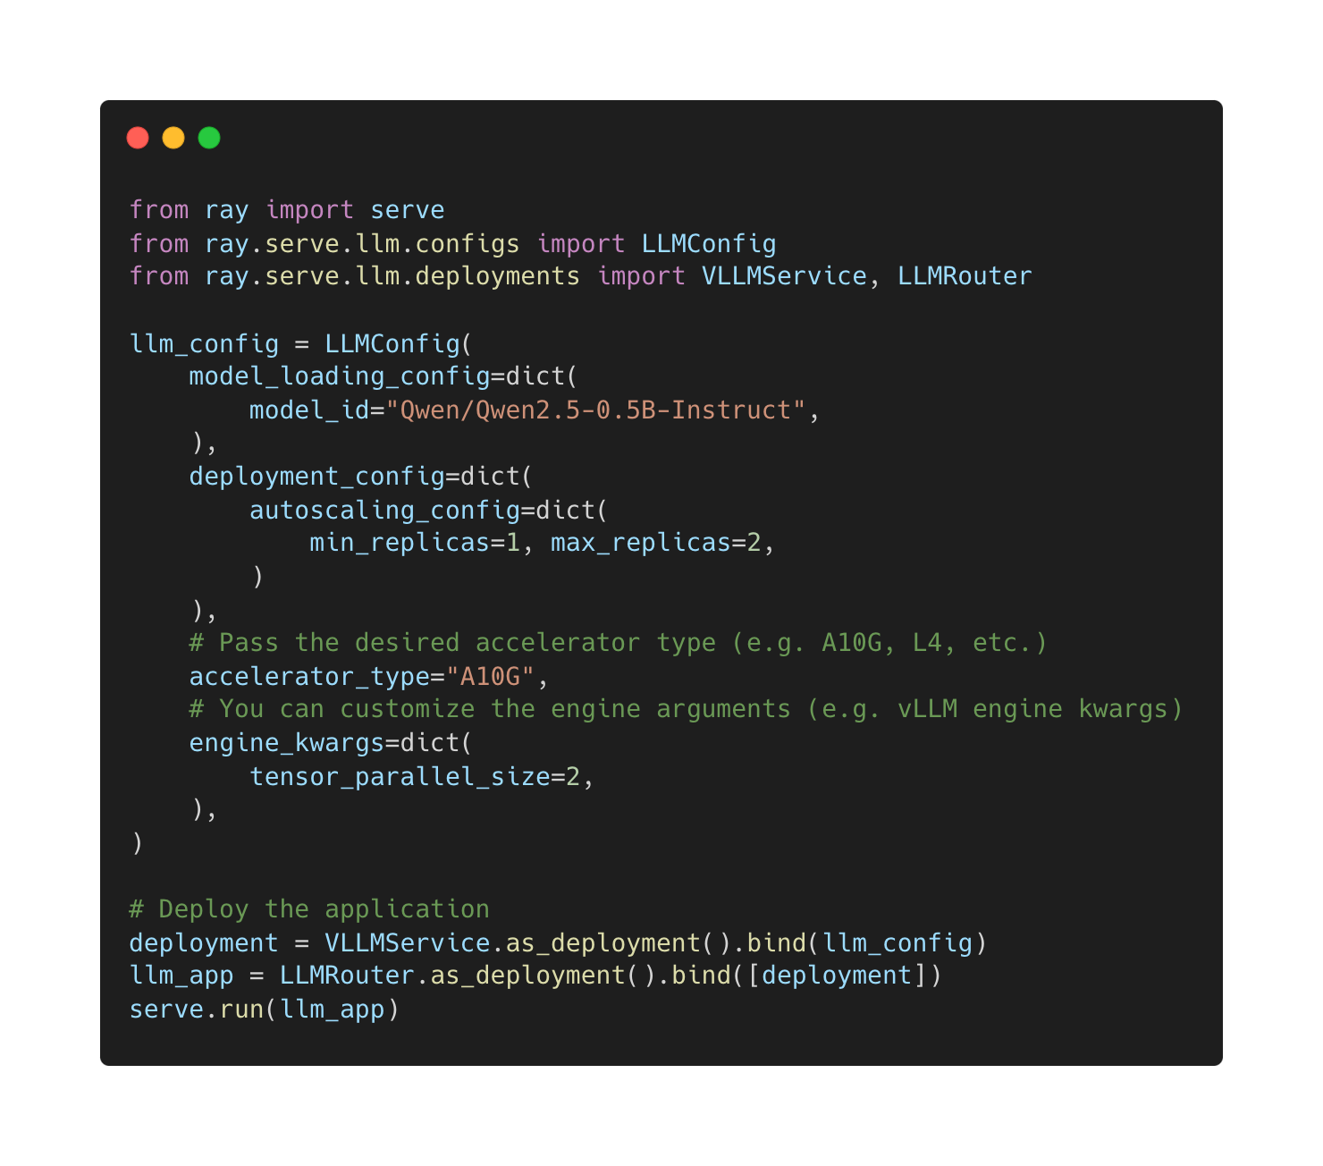

Pythonic vLLM production service with Ray.serve
Pythonic and extendible ray.serve application for scaling LLM engines for online inference
Features
⚡️ Automatic scaling and load balancing
🌐 Unified multi-node multi-model deployment
🔌 OpenAI compatible
🔄 Multi-LoRA support with shared base models
☁️ Cloud storage as model source (AWS, GCP)
Try out today
https://docs.ray.io/en/master/serve/llm/overview.html

Slide 32



vLLM batch inference with Ray.data
Prototyped pipeline with a sampled dataset and a single vLLM replica
Sampled
Preprocess (apply chat template, etc)
Postprocess (fetch results, etc)
Easy scale using ray.data.llm on Ray Data
ray.data.llm
Preprocess
Load Images
Apply Chat Template
Postprocess
Customizable data pipeline
Fully compatible vLLM interfaces
Scale out and deploy to Ray clusters with a single argument

Slide 33
Scale Out vLLM Batch Inference with Ray.data
Example – Batch inference with chat
# Step 1: Create a processor config
config = ray.data.llm.vLLMEngineProcessorConfig(
# Base HF model to use.
model="meta-llama/Llama-3.1-70B-Instruct",
engine_kwargs={
# Any vLLM engine arguments.
"pipeline_parallel_size": 2,
},
# The GPU type.
accelerator_type="L40S",
# The number of replicas to launch.
concurrency=100,
batch_size=64,
)
# Step 2: Create a vLLM processor
processor = ray.data.llm.build_llm_processor(
config,
preprocess=lambda row: dict(
messages=[
{"role": "system",
"content": "Introduce the given item"},
{"role": "user",
"content": row["item"]}
],
sampling_params=dict(
temperature=0.3,
max_tokens=250,
)
),
postprocess=lambda row: dict(
answer=row["generated_text"],
**row
),
)
# Step 3: Run the processor
ds = ray.data.read_parquet(...)
ds = processor(ds)
ds = ds.materialize()
Quick start: https://docs.ray.io/en/master/data/working-with-llms.html

Slide 34























Thank you sponsors (funding compute!)

Slide 35
Our Goal
Build the fastest and
easiest-to-use open-source
LLM inference & serving engine

Slide 36






Building the fastest and easiest-to-use open-source LLM inference & serving engine!
https://github.com/vllm-project/vllm
https://twitter.com/vllm_project
https://slack.vllm.ai
https://opencollective.com/vllm
https://www.linkedin.com/company/vllm-project

